Slide 1

Statistical Machine Learning
Unit – I

Slide 2
Introduction
Statistical modeling is the use of mathematical models and statistical assumptions to generate sample data and make predictions about the real world. A statistical model is a collection of probability distributions on a set of all possible outcomes of an experiment.
Machine learning is a branch of study in which a model can learn automatically from the experiences based on data without exclusively being modeled like in statistical models.

Slide 3
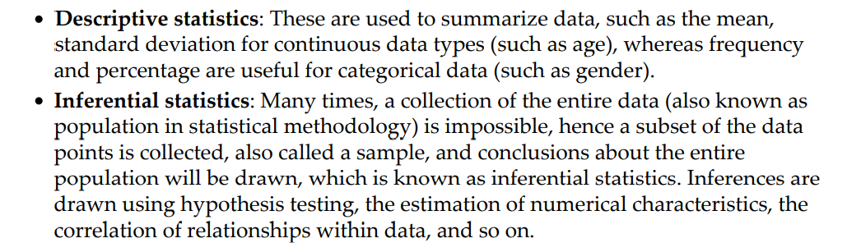
Statistical terminology for model building and validation
Statistics is the branch of mathematics dealing with the collection, analysis, interpretation, presentation, and organization of numerical data.
Statistics are mainly classified into two subbranches:
Statistical modeling is applying statistics on data to find underlying hidden relationships by analyzing the significance of the variables.

Slide 4
Machine learning
Machine learning is the branch of computer science that utilizes past experience to learn from and use its knowledge to make future decisions.
Machine learning is at the intersection of computer science, engineering, and statistics.
The goal of machine learning is to generalize a detectable pattern or to create an unknown rule from given examples.

Slide 5
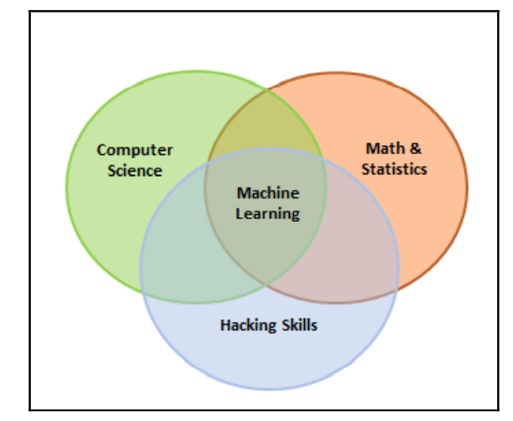
Machine learning
An overview of machine learning landscape is as follows:

Slide 6
Machine learning
Machine learning is broadly classified into three categories but nonetheless, based on the situation, these categories can be combined to achieve the desired results for particular applications:
Supervised Learning
Un Supervised Learning
Reinforcement Learning

Slide 7
Supervised learning:
This is teaching machines to learn the relationship between other variables and a target variable, similar to the way in which a teacher provides feedback to students on their performance.
The major segments within supervised learning are as follows:
Classification problem
Regression problem

Slide 8
Unsupervised Learning
In unsupervised learning, algorithms learn by themselves without any supervision or without any target variable provided.
It is a question of finding hidden patterns and relations in the given data.
The categories in unsupervised learning are as follows:
Dimensionality reduction
Clustering

Slide 9
Reinforcement Learning
This allows the machine or agent to learn its behavior based on feedback from the environment.
In reinforcement learning, the agent takes a series of decisive actions without supervision and, in the end, a reward will be given, either +1 or -1.
Based on the final payoff/reward, the agent reevaluates its paths.
Reinforcement learning problems are closer to the artificial intelligence methodology rather than frequently used machine learning algorithms.

Slide 10
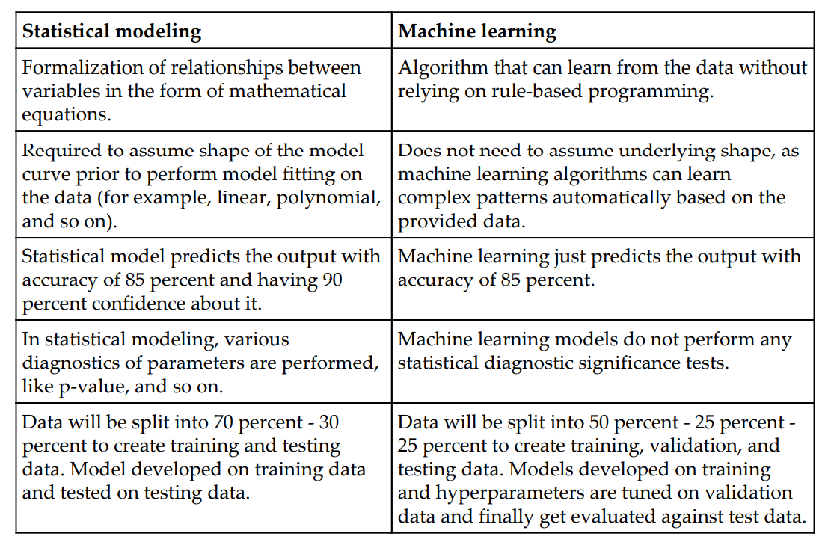
Major differences between statistical modeling and machine learning

Slide 11
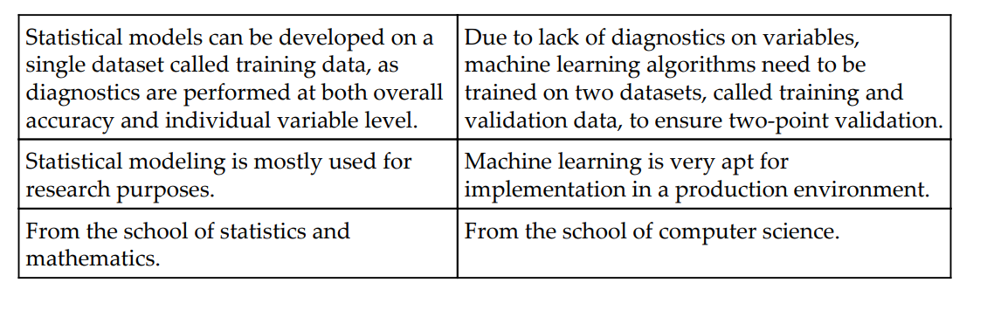
Major differences between statistical modeling and machine learning

Slide 12
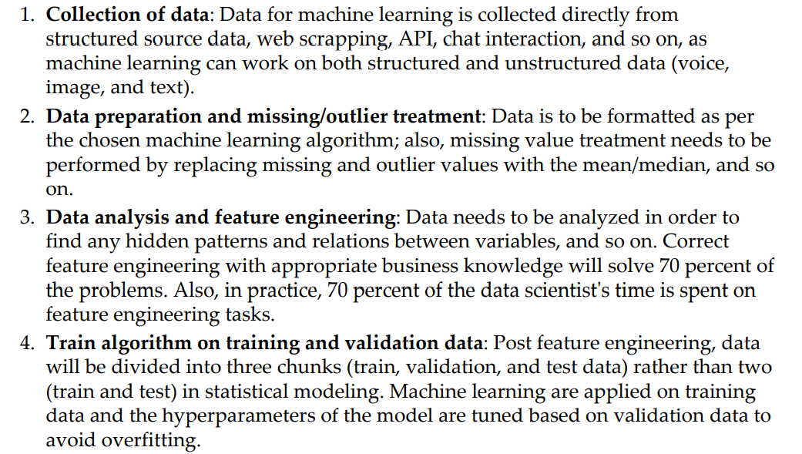
Steps in machine learning model development and deployment

Slide 13
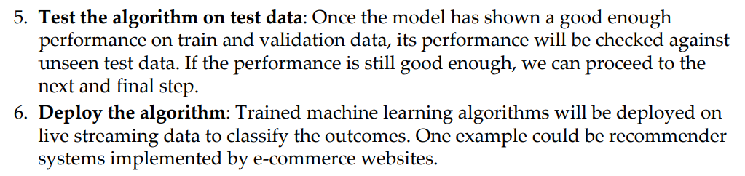
Steps in machine learning model development and deployment

Slide 14
Statistical fundamentals and terminology for model building and validation

Slide 15
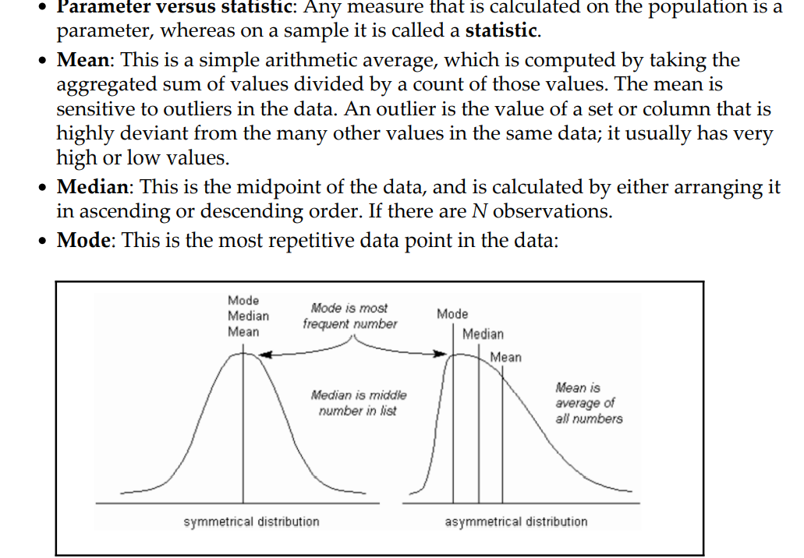
Statistical fundamentals and terminology for model building and validation

Slide 16
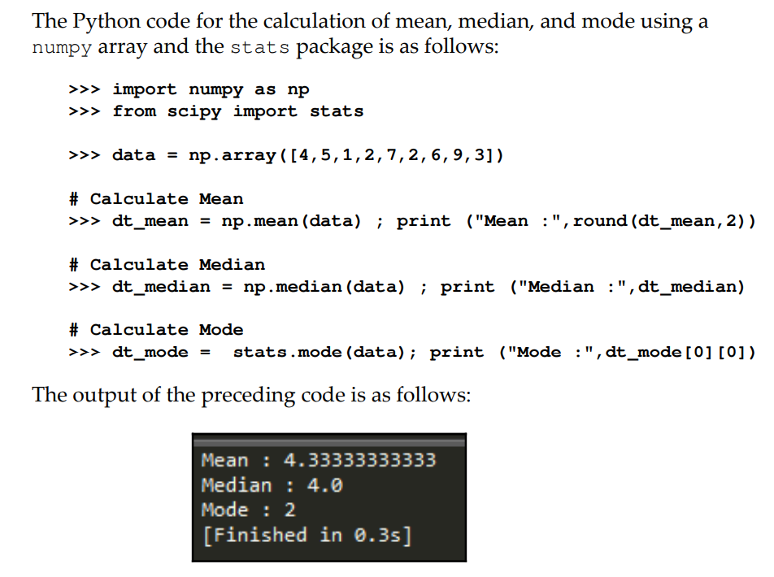
Statistical fundamentals and terminology for model building and validation

Slide 17
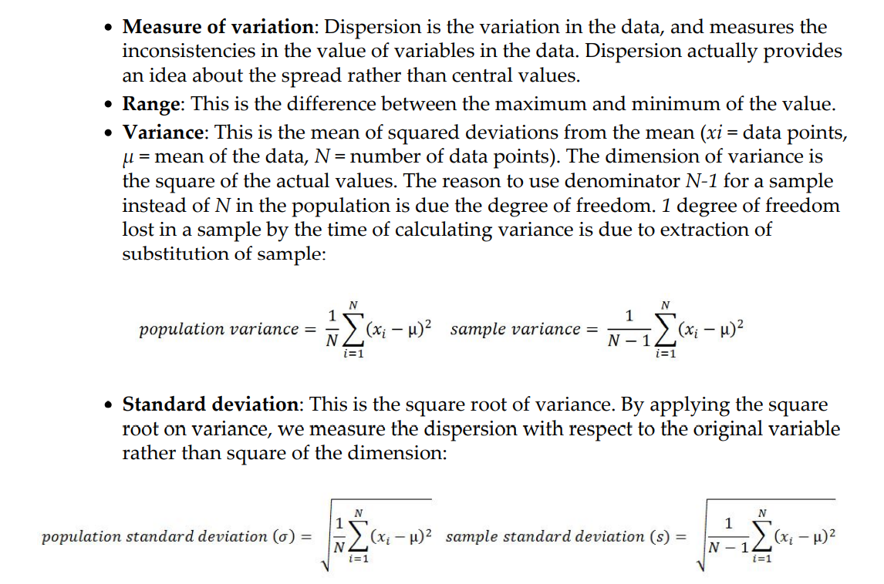
Statistical fundamentals and terminology for model building and validation

Slide 18
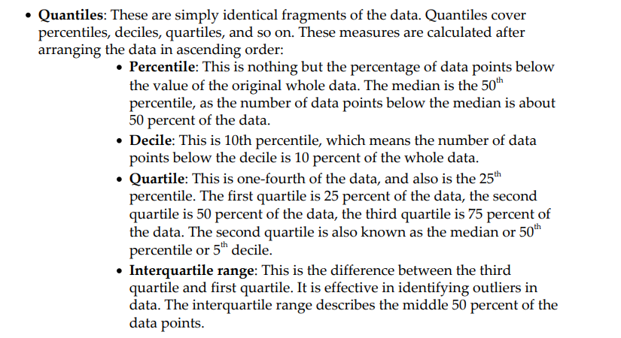
Statistical fundamentals and terminology for model building and validation

Slide 19
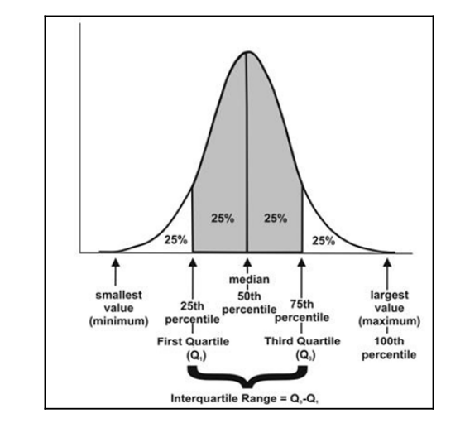
Statistical fundamentals and terminology for model building and validation

Slide 20
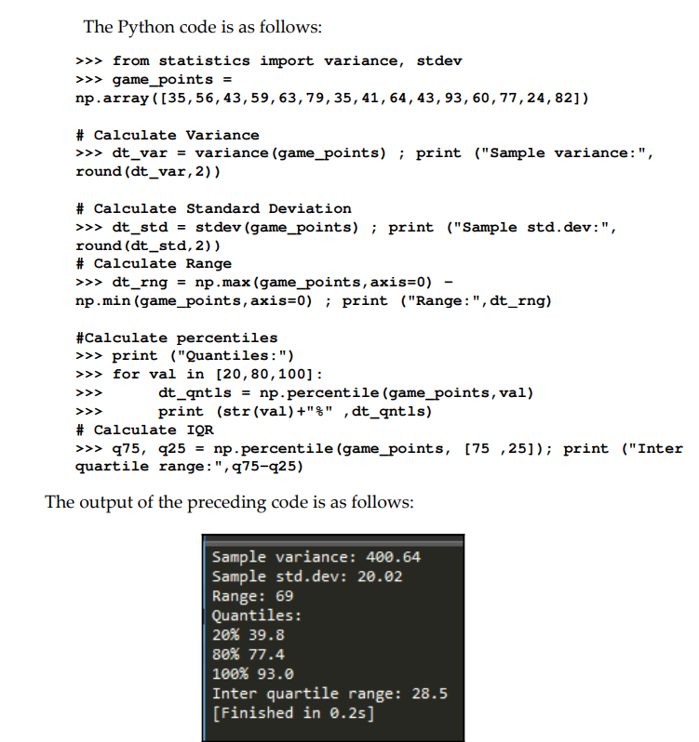
Statistical fundamentals and terminology for model building and validation

Slide 21
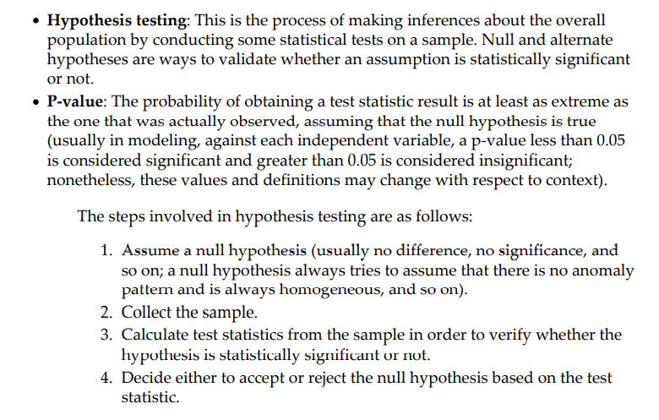
Statistical fundamentals and terminology for model building and validation

Slide 22
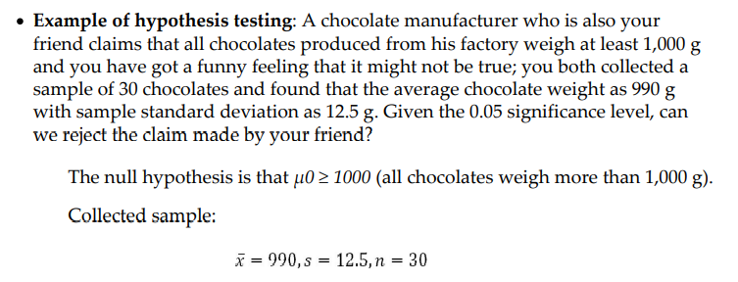
Statistical fundamentals and terminology for model building and validation

Slide 23
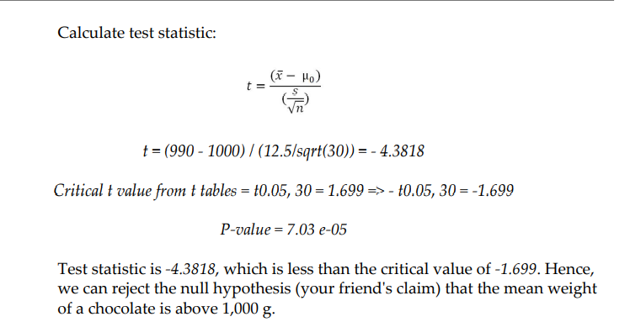
Statistical fundamentals and terminology for model building and validation

Slide 24
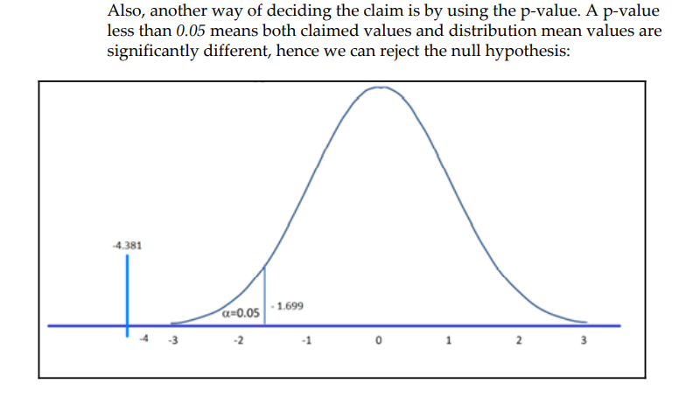
Statistical fundamentals and terminology for model building and validation

Slide 25
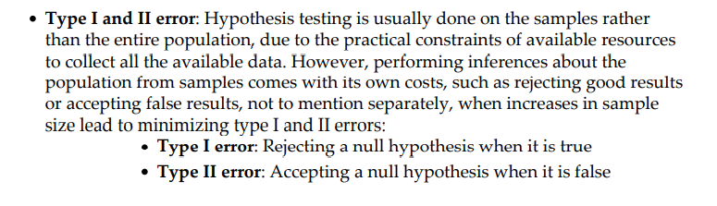
Statistical fundamentals and terminology for model building and validation

Slide 26
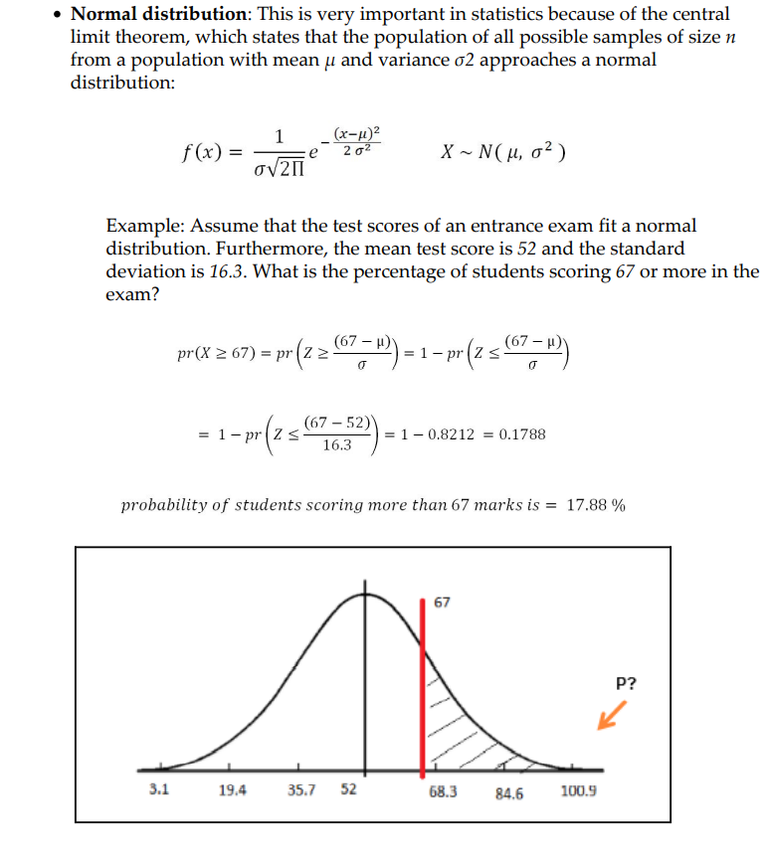
Statistical fundamentals and terminology for model building and validation

Slide 27
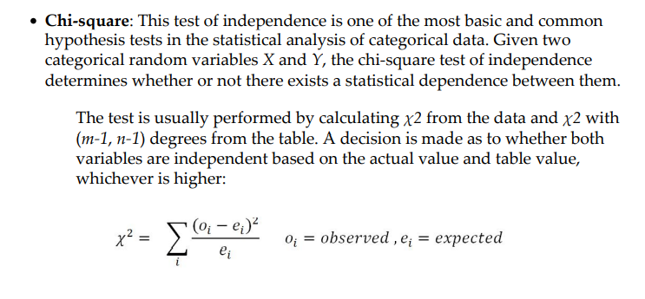
Statistical fundamentals and terminology for model building and validation

Slide 28
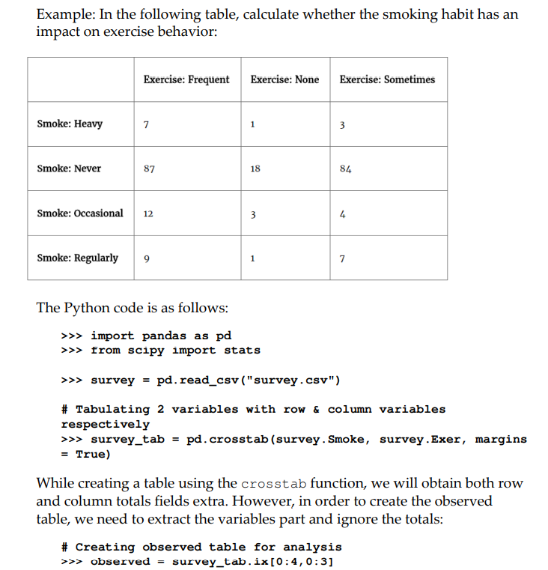
Statistical fundamentals and terminology for model building and validation

Slide 29
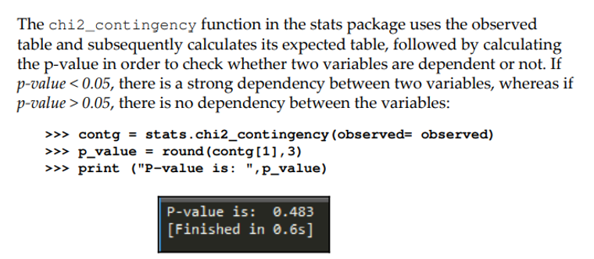
Statistical fundamentals and terminology for model building and validation

Slide 30
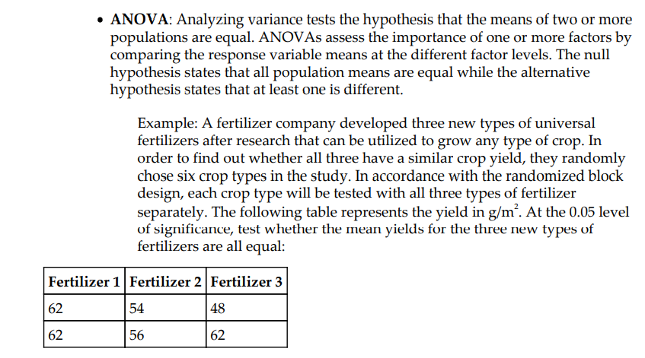
Statistical fundamentals and terminology for model building and validation

Slide 31
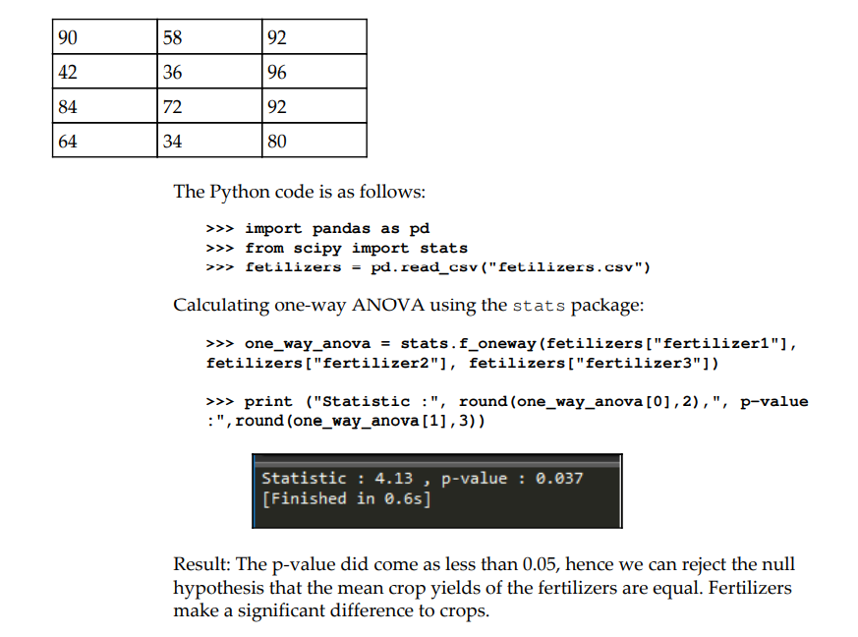
Statistical fundamentals and terminology for model building and validation

Slide 32
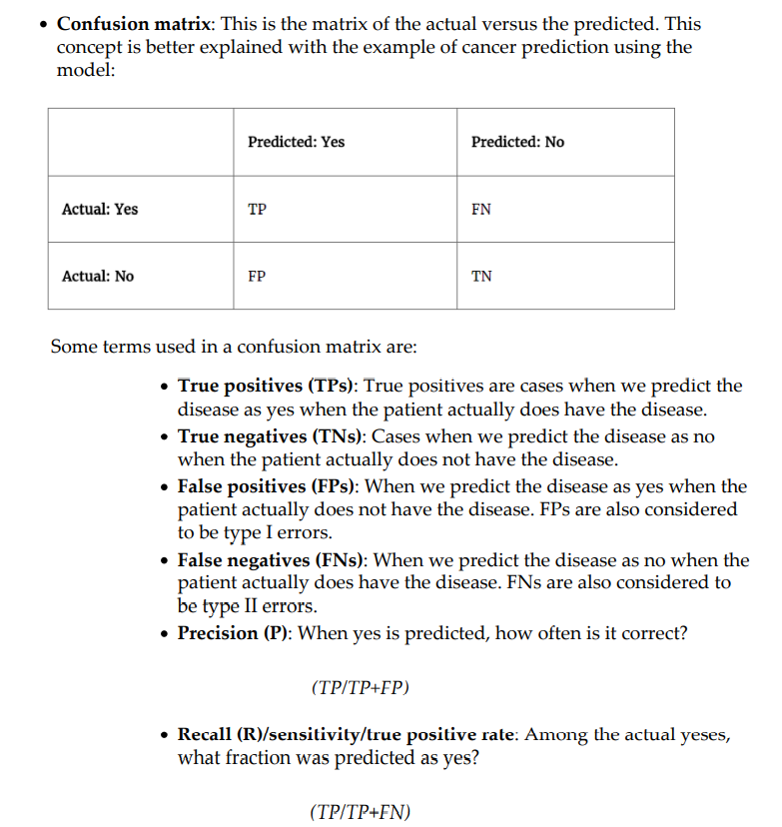
Statistical fundamentals and terminology for model building and validation

Slide 33
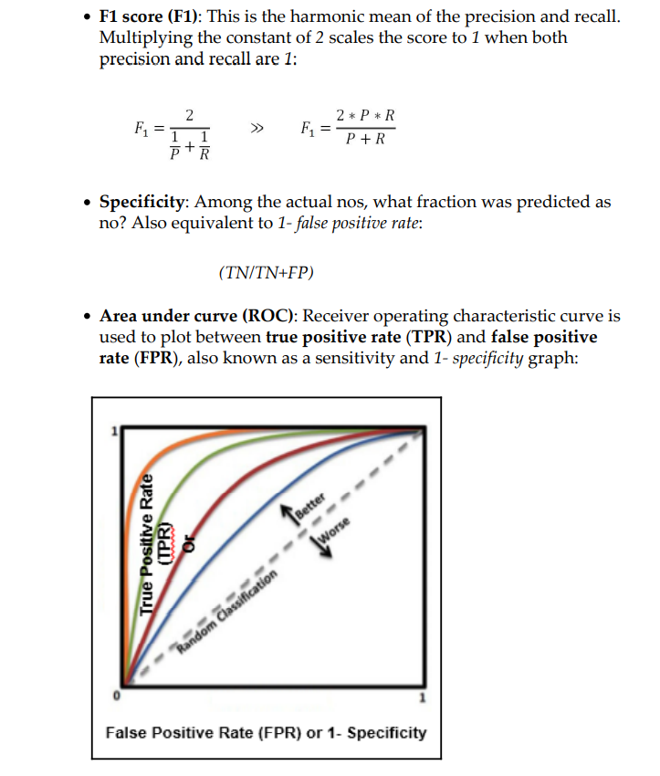
Statistical fundamentals and terminology for model building and validation

Slide 34
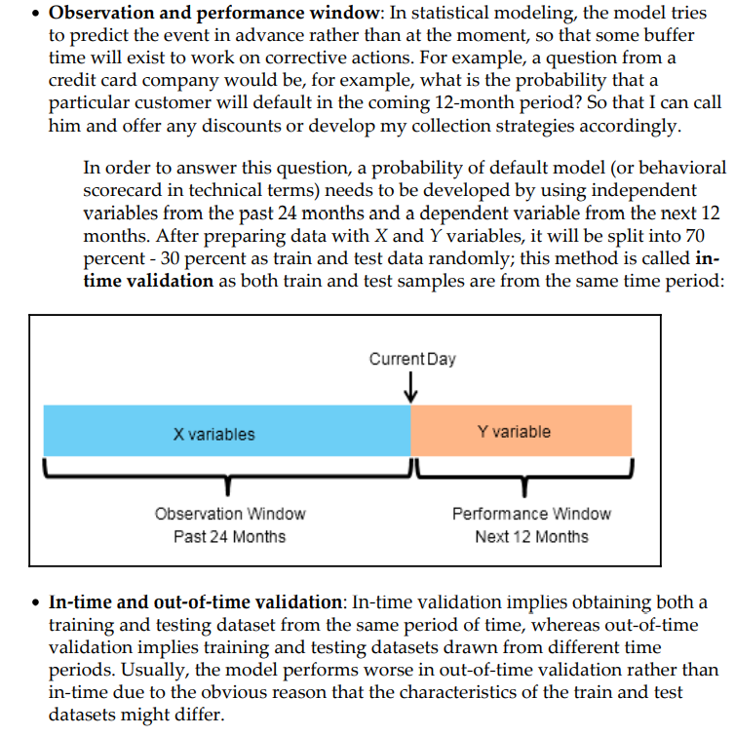
Statistical fundamentals and terminology for model building and validation

Slide 35
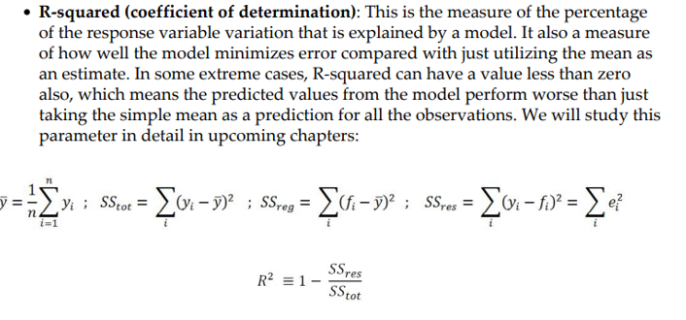
Statistical fundamentals and terminology for model building and validation
In statistics, the coefficient of determination, denoted R2 or r2 and pronounced "R squared", is the proportion of the variation in the dependent variable that is predictable from the independent variable(s).

Slide 36
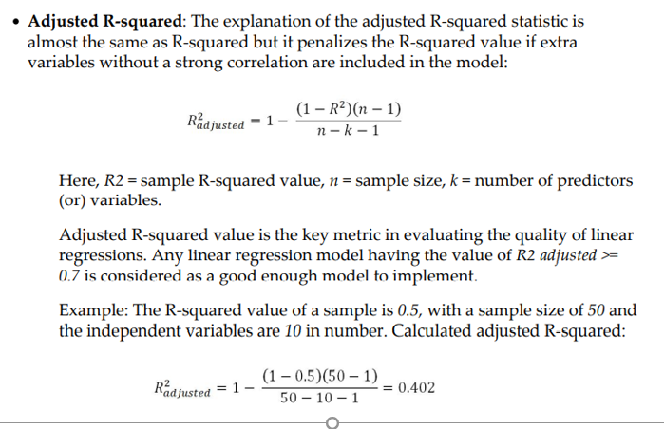
Statistical fundamentals and terminology for model building and validation
The Adjusted Coefficient of Determination (Adjusted R-squared) is an adjustment for the Coefficient of Determination that takes into account the number of variables in a data set. It also penalizes you for points that don't fit the model. ... Every time you add a data point in regression analysis, R² will increase.

Slide 37
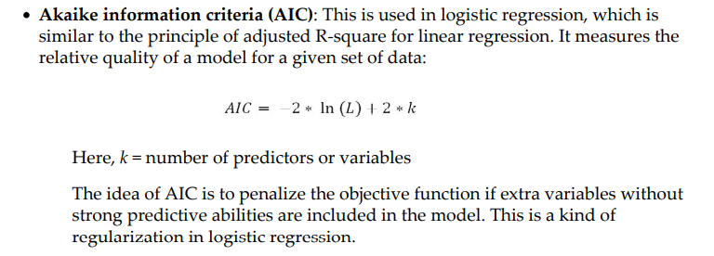
Statistical fundamentals and terminology for model building and validation
Maximum Likelihood estimate
Estimating the parameters with maximum likelihood

Slide 38
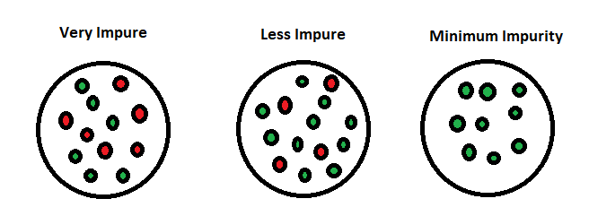
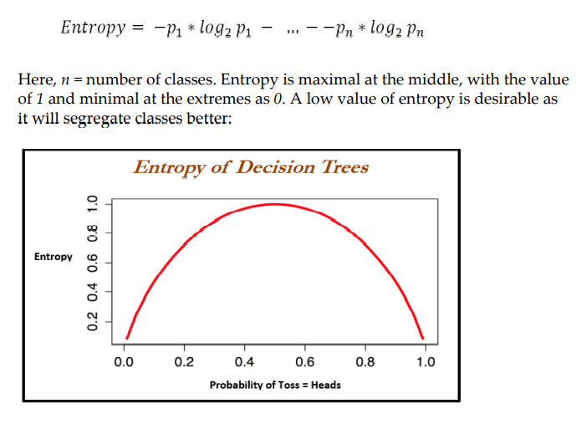
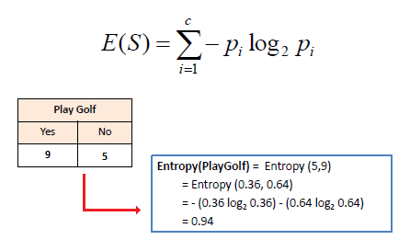
Statistical fundamentals and terminology for model building and validation
Entropy – measure of impurity in the data
If the sample is homogenous – entropy =0
If the sample is equally divided – entropy =1

Slide 39
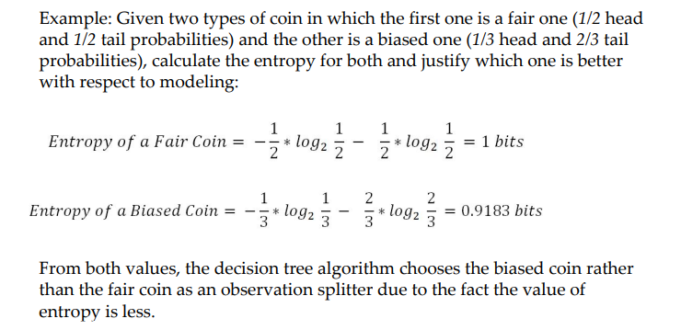
Statistical fundamentals and terminology for model building and validation

Slide 40
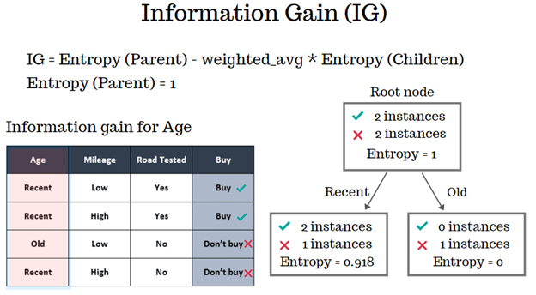
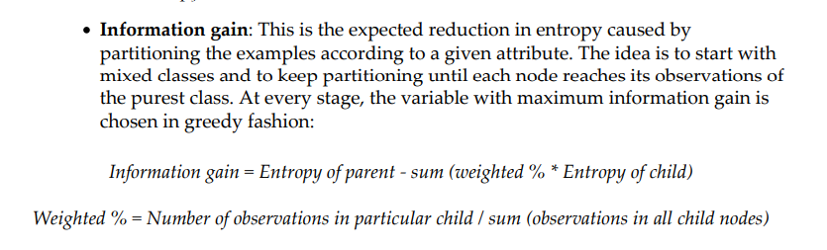
Statistical fundamentals and terminology for model building and validation
The information gain is the amount of information gained about a random variable or signal from observing another random variable.
Entropy is a measure of the uncertainty associated with a random variable.

Slide 41
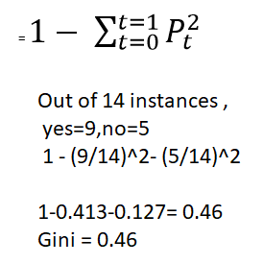
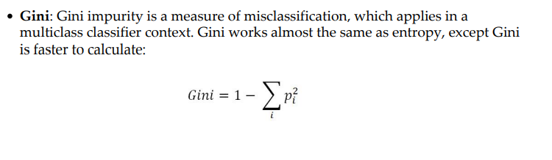
Statistical fundamentals and terminology for model building and validation
Gini index and entropy is the criterion for calculating information gain.
Both gini and entropy are measures of impurity of a node.
A node having multiple classes is impure whereas a node having only one class is pure.

Slide 42
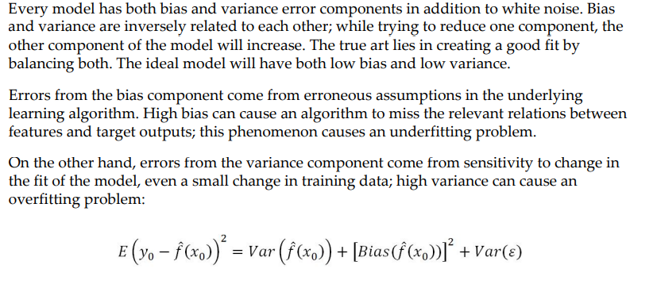
Bias versus variance trade-off
Bias and variance are inversely connected. It is impossible to have an ML model with a low bias and a low variance. When a data engineer modifies the ML algorithm to better fit a given data set, it will lead to low bias—but it will increase variance

Slide 43
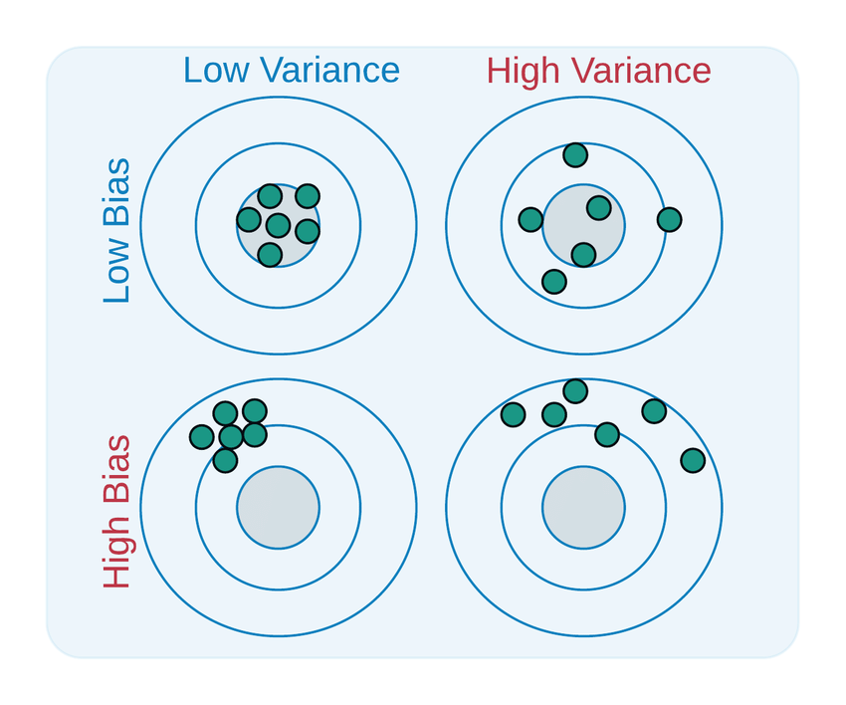
Bias versus variance trade-off

Slide 44
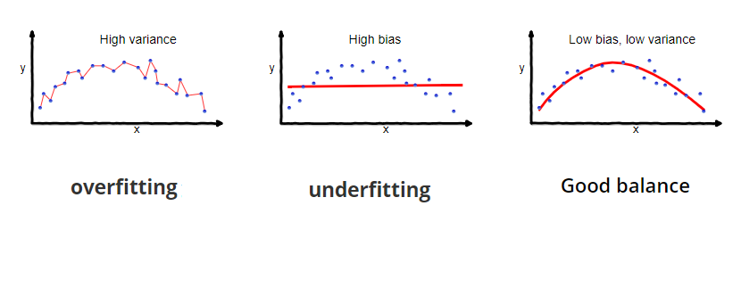
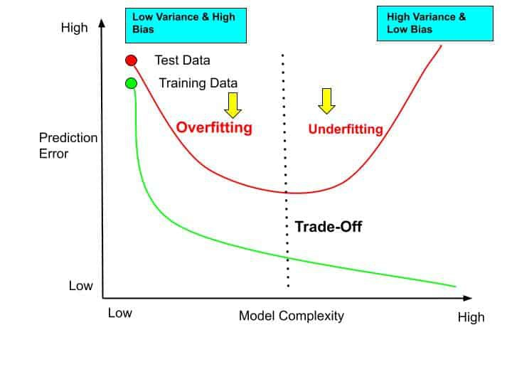
Bias versus variance trade-off

Slide 45
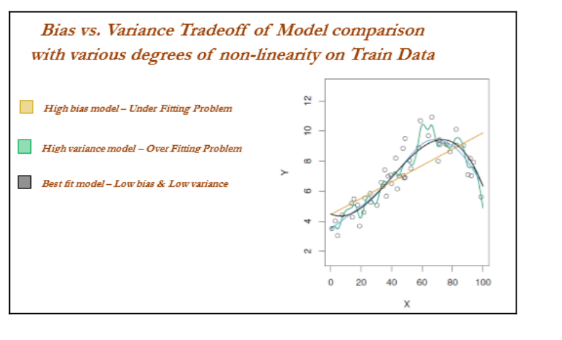

Slide 46
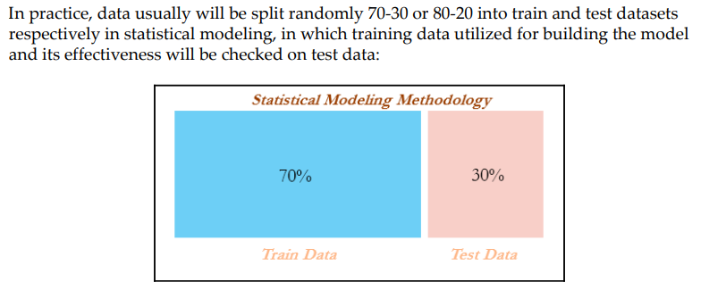
Train and test data

Slide 47
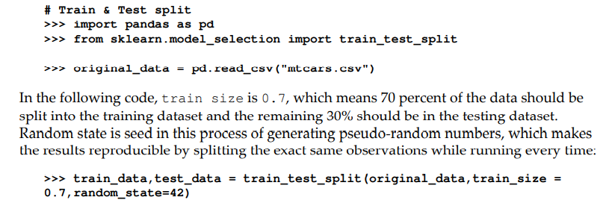
Train and test data

Slide 48
Linear regression versus gradient descent
Linear Regression
Linear regression analysis is used to predict the value of a variable based on the value of another variable.
The variable you want to predict is called the dependent variable.
The variable you are using to predict the other variable's value is called the independent variable.

Slide 49
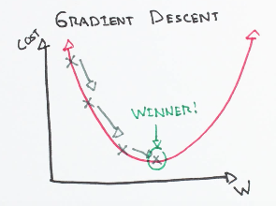
Linear regression versus gradient descent
Gradient descent is an optimization algorithm used to find the values of parameters (coefficients) of a function (f) that minimizes a cost function (cost).
Gradient descent is an optimization algorithm which is commonly-used to train machine learning models and neural networks. Training data helps these models learn over time, and the cost function within gradient descent specifically acts as a barometer, gauging its accuracy with each iteration of parameter updates.

Slide 50
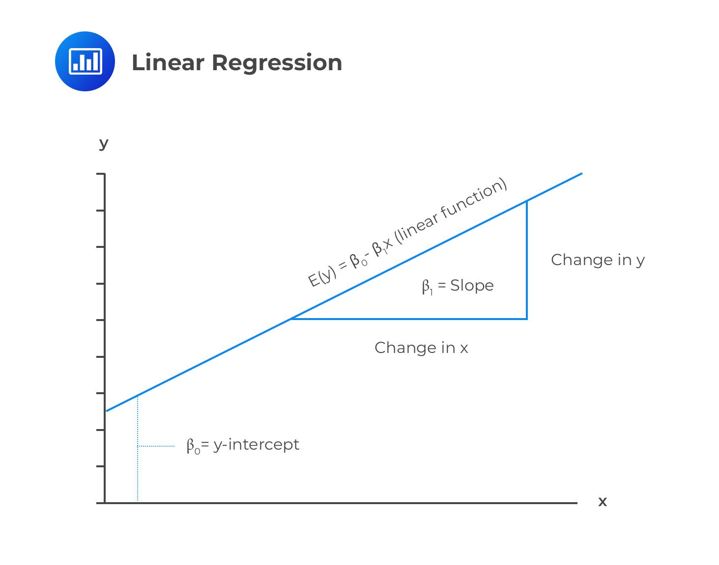
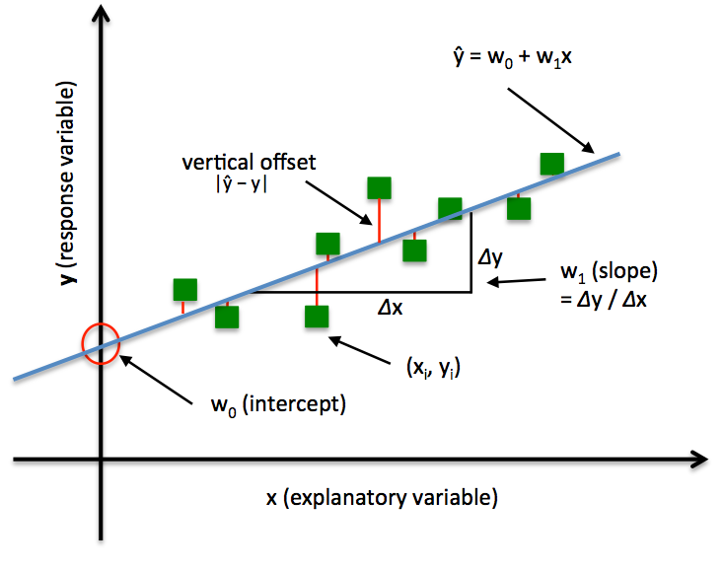
Linear regression

Slide 51
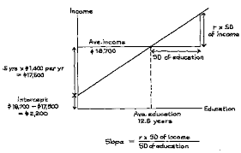
Linear regression

Slide 52
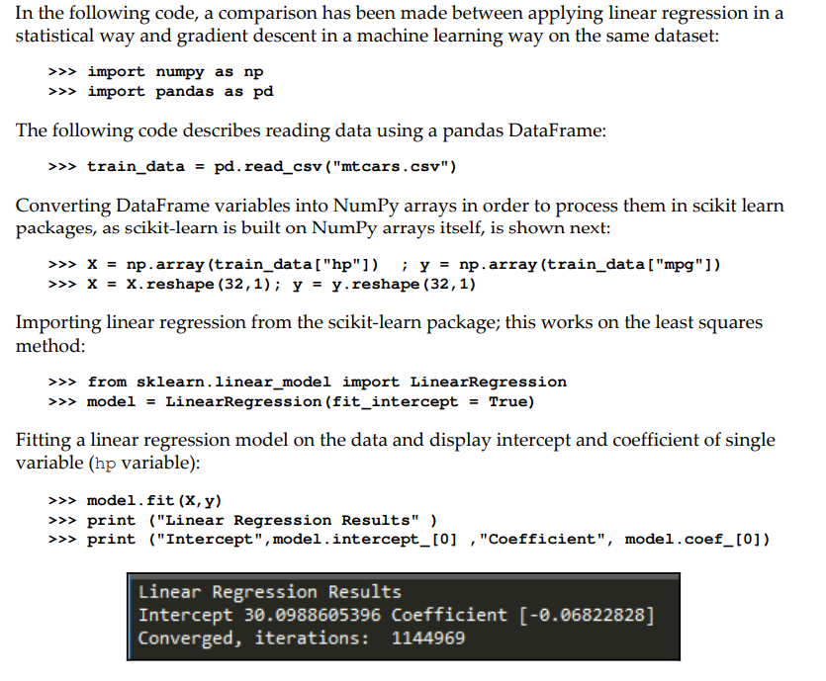
Linear regression versus gradient descent

Slide 53
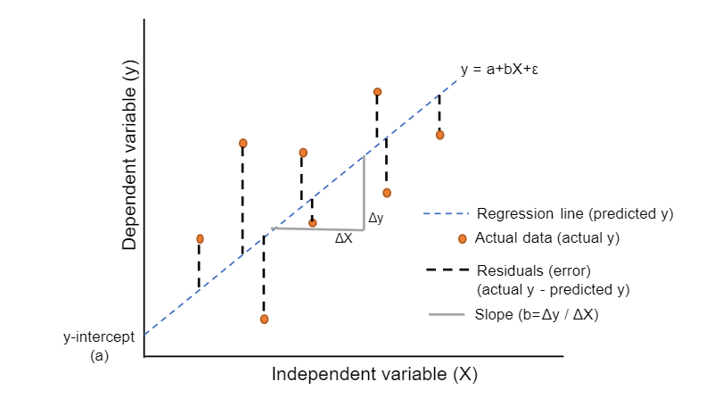
Linear regression versus gradient descent
The simple linear regression model is essentially a linear equation of the form y = c + b*x; where y is the dependent variable (outcome), x is the independent variable (predictor), b is the slope of the line; also known as regression coefficient and c is the intercept; labeled as constant.

Slide 54

Linear regression versus gradient descent

Slide 55


Slide 56

Linear regression versus gradient descent
Mean squared Error calculation
Mean squared error (MSE) measures the amount of error in statistical models. It assesses the average squared difference between the observed and predicted values.

Slide 57


Slide 58
Machine learning losses
Loss is the penalty for a bad prediction. That is, loss is a number indicating how bad the model's prediction was on a single example. If the model's prediction is perfect, the loss is zero; otherwise, the loss is greater.
The loss function or cost function in machine learning is a function that maps the values of variables onto a real number intuitively representing some cost associated with the variable values.
Optimization methods are applied to minimize the loss function by changing the parameter values, which is the central theme of machine learning.
Zero-one loss: The simplest loss function is the zero-one loss. It literally counts how many mistakes an hypothesis function h makes on the training set. For every single example it suffers a loss of 1 if it is mispredicted, and 0 otherwise.
Zero-one loss is L0-1 = 1 (m <= 0); in zero-one loss, value of loss is 0 for m >= 0 whereas 1 for m < 0.
The difficult part with this loss is it is not differentiable, non-convex, and also NP- hard.
Surrogate losses used for machine learning in place of zero-one loss
Types are
Squared loss (for regression)
Hinge loss (SVM)
Logistic/log loss (logistic regression)

Slide 59
Types of Losses
Squared loss is a loss function that can be used in the learning setting in which we are predicting a real-valued variable y given an input variable x.
The hinge loss is a loss function used for training classifiers, most notably the SVM. ... A negative distance from the boundary incurs a high hinge loss. This essentially means that we are on the wrong side of the boundary, and that the instance will be classified incorrectly.
Log Loss is the most important classification metric based on probabilities.For any given problem, a lower log loss value means better predictions. Mathematical interpretation: Log Loss is the negative average of the log of corrected predicted probabilities for each instance. Log-loss is indicative of how close the prediction probability is to the corresponding actual/true value (0 or 1 in case of binary classification). The more the predicted probability diverges from the actual value, the higher is the log-loss value

Slide 60




Some loss functions are as follows:

Slide 61

Machine learning losses

Slide 62
When to stop tuning machine learning models
While increasing the complexity of a model, the following stages occur:
Stage 1: Underfitting stage - high train and high test errors (or low train and low test accuracy)
Stage 2: Good fit stage (ideal scenario) - low train and low test errors (or high train and high test accuracy)
Stage 3: Overfitting stage - low train and high test errors (or high train and low test accuracy)

Slide 63

When to stop tuning machine learning models

Slide 64
Train, validation, and test data
Cross-validation is not popular in the statistical modeling world for many reasons;
statistical models are linear in nature and robust, and do not have a high variance/overfitting problem.
Hence, the model fit will remain the same either on train or test data, which does not hold true in the machine learning world.
Also, in statistical modeling, lots of tests are performed at the individual parameter level apart from aggregated metrics, whereas in machine learning we do not have visibility at the individual parameter level

Slide 65

Train, validation, and test data

Slide 66
Train, validation, and test data
>>> import pandas as pd
>>> from sklearn.model_selection import train_test_split
>>> original_data = pd.read_csv("mtcars.csv")
>>> def data_split(dat,trf = 0.5,vlf=0.25,tsf = 0.25):
... nrows = dat.shape[0]
... trnr = int(nrows*trf)
... vlnr = int(nrows*vlf)
The following Python code splits the data into training and the remaining data. The remaining data will be further split into validation and test datasets:
tr_data,rmng = train_test_split(dat,train_size = trnr,random_state=42)
... vl_data, ts_data = train_test_split(rmng,train_size = vlnr,random_state=45)
... return (tr_data,vl_data,ts_data)

Slide 67
Train, validation, and test data
Implementation of the split function on the original data to create three datasets (by 50 percent, 25 percent, and 25 percent splits) is as follows:
>>> train_data, validation_data, test_data = data_split (original_data
,trf=0.5, vlf=0.25,tsf=0.25)

Slide 68
Cross-validation
Cross-validation is a resampling method that uses different portions of the data to test and train a model on different iterations. It is mainly used in settings where the goal is prediction, and one wants to estimate how accurately a predictive model will perform in practice.

Slide 69

Cross-validation
Example: In five-fold cross-validation, data will be divided into five parts, subsequently trained on four parts of the data, and tested on the one part of the data. This process will run five times, in order to cover all points in the data. Finally, the error calculated will be the average of all the errors

Slide 70
Grid search
Grid-searching is the process of scanning the data to configure optimal parameters for a given model. Depending on the type of model utilized, certain parameters are necessary.
Grid-searching can be applied across machine learning to calculate the best parameters to use for any given model.
Grid search in machine learning is a popular way to tune the hyperparameters of the model in order to find the best combination for determining the best fit

Slide 71
Grid search
Grid search has been implemented using a decision tree classifier for classification purposes.
Tuning parameters are the depth of the tree, the minimum number of observations in terminal node, and the minimum number of observations required to perform the node split
# Grid search
>>> import pandas as pd
>>> from sklearn.tree import DecisionTreeClassifier
>>> from sklearn.model_selection import train_test_split
>>> from sklearn.metrics import classification_report,confusion_matrix,accuracy_score
>>> from sklearn.pipeline import Pipeline
>>> from sklearn.grid_search import GridSearchCV
>>> input_data = pd.read_csv("ad.csv",header=None)
>>> X_columns = set(input_data.columns.values)
>>> y = input_data[len(input_data.columns.values)-1]
>>> X_columns.remove(len(input_data.columns.values)-1)
>>> X = input_data[list(X_columns)]

Slide 72
Grid search
Split the data into train and testing:
>>> X_train, X_test,y_train,y_test = train_test_split(X,y,train_size = 0.7,random_state=33)
Create a pipeline to create combinations of variables for the grid search:
>>> pipeline = Pipeline([
... ('clf', DecisionTreeClassifier(criterion='entropy')) ])
Combinations to explore are given as parameters in Python dictionary format:
>>> parameters = {
... 'clf max_depth': (50,100,150),
... 'clf min_samples_split': (2, 3),
... 'clf min_samples_leaf': (1, 2, 3)}

Slide 73
Grid search
The n_jobs field is for selecting the number of cores in a computer; -1 means it uses all the cores in the computer. The scoring methodology is accuracy, in which many other options can be chosen, such as precision, recall, and f1:
>>> grid_search = GridSearchCV(pipeline, parameters, n_jobs=-1, verbose=1, scoring='accuracy')
>>> grid_search.fit(X_train, y_train)
Predict using the best parameters of grid search:
>>> y_pred = grid_search.predict(X_test)

Slide 74
Grid search
The output is as follows:
>>> print ('\n Best score: \n', grid_search.best_score_)
>>> print ('\n Best parameters set: \n')
>>> best_parameters = grid_search.best_estimator_.get_params()
>>> for param_name in sorted(parameters.keys()):
>>> print ('\t%s: %r' % (param_name, best_parameters[param_name]))
>>> print ("\n Confusion Matrix on Test data
\n",confusion_matrix(y_test,y_pred))
>>> print ("\n Test Accuracy \n",accuracy_score(y_test,y_pred))
>>> print ("\nPrecision Recall f1 table \n",classification_report(y_test, y_pred))

Slide 75

Grid search

Slide 76
Machine learning model overview
Supervised learning: This is where an instructor provides feedback to a student on whether they have performed well in an examination or not. In which target variable do present and models do get tune to achieve it. Many machine learning methods fall in to this category
Classification problems
Logistic regression
Lasso and ridge regression
Decision trees (classification trees)
Bagging classifier
Random forest classifier
Boosting classifier (adaboost, gradient boost, and xgboost)
SVM classifier
Recommendation engine
Regression problems
Linear regression (lasso and ridge regression)
Decision trees (regression trees)
Bagging regressor
Random forest regressor
Boosting regressor - (adaboost, gradient boost, and xgboost)
SVM regressor

Slide 77
Machine learning model overview
Unsupervised learning: Similar to the teacher-student analogy, in which the instructor does not present and provide feedback to the student and who needs to prepare on his/her own. Unsupervised learning does not have as many are in supervised learning:
Principal component analysis (PCA)
K-means clustering
Reinforcement learning: This is the scenario in which multiple decisions need to be taken by an agent prior to reaching the target and it provides a reward, either +1 or -1, rather than notifying how well or how badly the agent performed across the path
Markov decision process
Monte Carlo methods
Temporal difference learning

Slide 78
Machine learning model overview
Logistic regression:
This is the problem in which outcomes are discrete classes rather than continuous values.
For example, a customer will arrive or not, he will purchase the product or not, and so on.
In statistical methodology, it uses the maximum likelihood method to calculate the parameter of individual variables.
In contrast, in machine learning methodology, log loss will be minimized with respect to β coefficients (also known as weights).
Logistic regression has a high bias and a low variance error
Linear regression:
This is used for the prediction of continuous variables such as customer income and so on.
It utilizes error minimization to fit the best possible line in statistical methodology.
However, in machine learning methodology, squared loss will be minimized with respect to β coefficients.
Linear regression also has a high bias and a low variance error

Slide 79
Machine learning model overview
Lasso and ridge regression:
This uses regularization to control overfitting issues by applying a penalty on coefficients.
In ridge regression, a penalty is applied on the sum of squares of coefficients
In lasso, a penalty is applied on the absolute values of the coefficients.
Ridge regression tries to minimize the magnitude of coefficients, whereas lasso tries to eliminate them
Decision trees:
Recursive binary splitting is applied to split the classes at each level to classify observations to their purest class.
The classification error rate is simply the fraction of the training observations in that region that do not belong to the most common class.
Decision trees have an overfitting problem due to their high variance in a way to fit
Pruning is applied to reduce the overfitting problem by growing the tree completely.
Decision trees have low a bias and a high variance error

Slide 80
Machine learning model overview
Bagging:
This is an ensemble technique applied on decision trees in order to minimize the variance error and at the same time not increase the error component due to bias.
In bagging, various samples are selected with a subsample of observations and all variables (columns), subsequently fit individual decision trees independently on each sample and later ensemble the results by taking the maximum vote (in regression cases, the mean of outcomes calculated
Random forest:
In bagging, all the variables/columns are selected for each sample, whereas in random forest a few subcolumns are selected.
The reason behind the selection of a few variables rather than all was that during each independent tree sampled, significant variables always came first in the top layer of splitting which makes all the trees look more or less similar and defies the sole purpose of ensemble:
Random forest has both low bias and variance errors

Slide 81
Machine learning model overview
Boosting:
This is a sequential algorithm that applies on weak classifiers such as a decision stump (a one-level decision tree or a tree with one root node and two terminal nodes) to create a strong classifier by ensembling the results.
The algorithm starts with equal weights assigned to all the observations, followed by subsequent iterations where more focus was given to misclassified observations by increasing the weight of misclassified observations and decreasing the weight of properly classified observations.
In the end, all the individual classifiers were combined to create a strong classifier. Boosting might have an overfitting problem, but by carefully tuning the parameters, we can obtain the best of the self machine learning model
Support vector machines (SVMs):
This maximizes the margin between classes by fitting the widest possible hyperplane between them.
In the case of non-linearly separable classes, it uses kernels to move observations into higher-dimensional space and then separates them linearly with the hyperplane there

Slide 82
Machine learning model overview
Recommendation engine:
This utilizes a collaborative filtering algorithm to identify high-probability items to its respective users, who have not used it in the past, by considering the tastes of similar users who would be using that particular item.
It uses the alternating least squares (ALS) methodology to solve this problem
Principal component analysis (PCA):
This is a dimensionality reduction technique in which principal components are calculated in place of the original variable.
Principal components are determined where the variance in data is maximum; subsequently, the top n components will be taken by covering about 80 percent of variance and will be used in further modeling processes, or exploratory analysis will be performed as unsupervised learning

Slide 83
Machine learning model overview
K-means clustering:
This is an unsupervised algorithm that is mainly utilized for segmentation exercise.
K-means clustering classifies the given data into k clusters in such a way that, within the cluster, variation is minimal and across the cluster, variation is maximal
Markov decision process (MDP):
In reinforcement learning, MDP is a mathematical framework for modeling decision-making of an agent in situations or environments where outcomes are partly random and partly under control.
In this model, environment is modeled as a set of states and actions that can be performed by an agent to control the system's state. The objective is to control the system in such a way that the agent's total payoff is maximized

Slide 84
Machine learning model overview
Monte Carlo method:
Monte Carlo methods do not require complete knowledge of the environment, in contrast with MDP.
Monte Carlo methods require only experience, which is obtained by sample sequences of states, actions, and rewards from actual or simulated interaction with the environment.
Monte Carlo methods explore the space until the final outcome of a chosen sample sequences and update estimates accordingly
Temporal difference learning:
Temporal difference is a combination of both Monte Carlo and dynamic programming ideas.
Similar to Monte Carlo, temporal difference methods can learn directly from raw experience without a model of the environment's dynamics.
Like dynamic programming, temporal difference methods update estimates based in part on other learned estimates, without waiting for a final outcome.
Temporal difference is the best of both worlds and is most commonly used in games such as AlphaGo and so on

